Slide 1
Cloud Computing Types

Slide 2
What is This “Cloud” thing?

Slide 3
Cloud Computing
“The practice of using a network of remote servers hosted on the Internet to store, manage, and process data, rather than a local server or a personal computer.”
In other words, having someone else host your servers and/or services for you.

Slide 4
Cloud Services Overview
Typically utilizes Virtualization or Containers to keep costs down while offering a larger number of services.
Shared resource model helps make the best use of hardware.
Providers have varying chargeback models to customers:
By amount of data stored (per mb/gb/tb)
By bandwidth used (mb/hr, gb/week, gb/month, etc..)
By resources used (ram, cpu)
By number of users accessing the service
Or combinations of all of the above.

Slide 5
Benefits of Cloud Services
Costs - Helps companies avoid up front costs of infrastructure
Anywhere/anytime - You can use the service whenever and wherever you wish (provided you have an internet connection)
Management - Servers/services can be partially or fully managed by the cloud provider
Network - Cloud computing can deliver increased bandwidth
Economies of Scale - Cloud providers take advantage of the sharing of redundant resources to reduce costs and increase scale.
Scalability - In addition it is easy to scale cloud services because providers have already invested in infrastructure.
Deployment - quick deployment compared to in house solutions.
Backup – Backup and recovery are sped up and simplified since the data resides at the cloud provider.

Slide 6
Drawbacks to Cloud Services
Big data - Not easy to move huge datasets in and out of the cloud.
Control - Reduced control for customers who want or need it.
Integration - The silo effect exists; when you have multiple cloud services hosting your data, integration across them and with your own network can be daunting (if possible at all).
Security – how do you know your data is safe?
Costs - Increased long term costs over in house solutions.
Customization - Can reduce flexibility of services offered
Support - Places reliance on cloud provider to fix issues
Features – often features are not on par with in house solutions
Regulatory Compliance – some industries are not permitted to store data off premises.

Slide 7
Cloud Service Models

Slide 8
Cloud Services on the Internet
Cloud computing is an extension of the service model to the ubiquities of the internet.
Don’t want to deal with datacenters or servers? Try Infrastructure as a Service!
Don’t want to bother with the infrastructure and the components required by your service? Try Platform as a Service!
Heck, don’t want to bother with any of it? Then Software as a Service is for you!

Slide 9
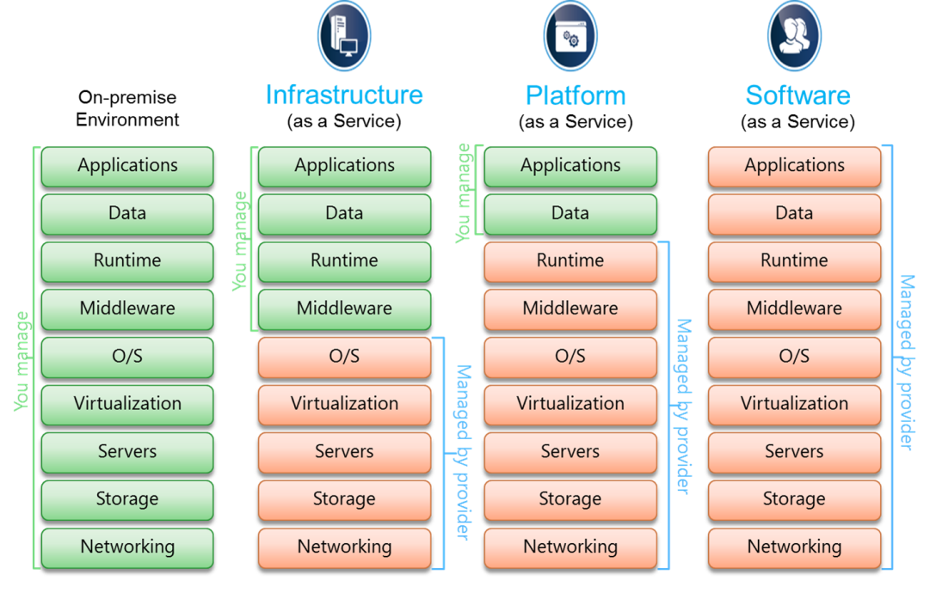
Cloud Service Models Comparison

Slide 10
Infrastructure as a Service (IAAS)
The most basic cloud-service model
Provides you with virtual infrastructure, for example servers and data storage space.
Virtualization plays a major role in this mode, by allowing IaaS-cloud providers to supply resources on-demand extracting them from their large pools installed in data centers.
High level of flexibility, but requires greater IT skillsets.
Sales Pitch: “Let us handle your hardware (as virtual machines). You handle the rest”
Examples: Amazon EC2, GoGrid, RackSpace

Slide 11
What is IaaS? Infrastructure as a Service | Microsoft Azure
Virtual Machines (VMs) for Linux and Windows | Microsoft Azure
Types of cloud computing (amazon.com)
Amazon EC2
What is IaaS (Infrastructure as a Service)? | Google Cloud
Compute Engine: Virtual Machines (VMs) | Google Cloud

Slide 12
Platform as a Service (PAAS)
Cloud providers deliver you the development environment for services where the user can develop and run in-house built applications.
These services might include an operating system, a programming language execution environment, databases and web servers.
Still offers shops flexibility to develop and customize their applications, but requires less of a skillset than IAAS as they no longer need to know how to setup and manage the infrastructure and Operating Systems.
Containers in the cloud are an example of PaaS
Sales Pitch: “We give you a setup so you can install or build your own app. No need to worry about the system administration.”
Examples: Google App Engine, Heroku, Microsoft Azure App Service, Docker Cloud

Slide 13
What is PaaS? Platform as a Service | Microsoft Azure
Azure Container Instances | Microsoft Azure
Amazon ECS | Container Orchestration Service | Amazon Web Services

Slide 14
Software as a Service (SAAS)
Provides you with access to already developed applications that are running in the cloud.
The access is achieved by cloud clients and the cloud users do not manage the infrastructure where the application resides, eliminating with this the way the need to install and run the application on the cloud user’s own computers.
This is method requires the least amount of IT skillsets in house, but also reduces or eliminates flexibility and control over how the service should function.
Sales Pitch: “We give you the apps, all you need to do is your job!”
Examples: Salesforce.com, Office 365, Google Apps, Quickbooks Pro online, Draw.io

Slide 15
What is SaaS? Software as a Service | Microsoft Azure
AWS Elemental MediaConvert (amazon.com)
Media Translation | Google Cloud
Transcoder API documentation | Transcoder API Documentation (google.com)

Slide 16
SLAs and the Cloud

Slide 17

SLAs for the Cloud
Get it in writing!

Slide 18
SLA – What is it?
A service-level agreement (SLA) defines the level of service expected by a customer from a vendor
Lays out the:
Metrics by which that service is measured
Remedies or penalties, if any, should the agreed-on service levels not be achieved.
Usually, SLAs are between companies and external suppliers, but they may also be between two departments within a company.

Slide 19
SLA – Why do we need one?
They clearly state metrics, responsibilities and expectations so that, in the event of issues with the service, neither party can plead ignorance. It ensures both sides have the same understanding of requirements.
Any significant contract without an associated SLA (reviewed by legal counsel) is open to deliberate or inadvertent misinterpretation. The SLA protects both parties in the agreement.
SLAs should be aligned to the technology or business objectives of the engagement. Misalignment can have a negative impact on deal pricing, quality of service delivery, and customer experience.

Slide 20
SLA – Who creates it?
Most service providers have a standard one
They can be a good starting point for negotiation.
These should be reviewed and modified by the customer and legal counsel,
They are usually slanted in favor of the vendor.
Don’t pass off the negotiation process to the legal department
Is legal responsible for delivering and managing your cloud services?

Slide 21
SLA – What is included?
The SLA should include components in two areas:
Services
include specifics of services provided
standards such as time window for each level of service (prime time and non-prime time may have different service levels, for example)
responsibilities of each party, escalation procedures, and cost/service tradeoffs
Management
definitions of measurement standards and methods
a dispute resolution process
an indemnification clause protecting the customer from third-party litigation resulting from service level breaches (this should already be covered in the contract, however)
a mechanism for updating the agreement as required.
This last item is critical; service requirements and vendor capabilities change, so there must be a way to make sure the SLA is kept up-to-date.

Slide 22
In Practice
Need for CIOs to "negotiate, contract, and work with suppliers has grown significantly and will increase further.
Most transitions to a cloud computing solution entail a change from a technically managed solution ("I build it, I maintain it") to a contractually managed solution ("Someone else is doing this for me)
How does the CIO & Cloud Manager ensure the vendor is doing what they're supposed to?
This change necessitates increased IT contract negotiation skills to establish the terms of the relationship ("What do I get?") and vendor management skills to maintain the relationship ("How do I ensure that I get it?").

Slide 23
SLA Common Parts
Definitions
Remedies
Data issues
Ownership of Data
Disposition of Data
Destruction of Data
Data Breaches
Data Location
Requests for Data
Security of Infrastructure
Audits & Inspections
DR and BC
Functionality
Pricing

Slide 24
Definitions
Examples from the Google Cloud SLA
"Downtime" means, for a domain, if there is more than a five percent user error rate. Downtime is measured based on server side error rate.
"Downtime Period" means, for a domain, a period of ten consecutive minutes of Downtime. Intermittent Downtime for a period of less than ten minutes will not be counted towards any Downtime Periods.
"Monthly Uptime Percentage" means total number of minutes in a calendar month minus the number of minutes of Downtime suffered from all Downtime Periods in a calendar month, divided by the total number of minutes in a calendar month.
"Scheduled Downtime" means those times where Google notified Customer of periods of Downtime at least five days prior to the commencement of such Downtime. There will be no more than twelve hours of Scheduled Downtime per calendar year. Scheduled Downtime is not considered Downtime for purposes of this Google Apps SLA, and will not be counted towards any Downtime Periods.

Slide 25
Remedies
SLAs must be enforceable, and they should state specific remedies such as corrections or penalties, for when they are not met.
Corrections codify the actions the service provider must take to prevent a future failure to meet an SLA. Penalties often take the form of a financial credit.
For example: If Google does not meet the Google Apps SLA, and if Customer meets its obligations under this Google Apps SLA, Customer will be eligible to receive the Service Credits described below...
Service Credit shall be applied as liquidated damages against the following year of service cost. If service is discontinued for any reason, the Service Credit shall be in the form of a rebate at the end of service.
Service Credits shall be computed by dividing the number of Days of Service credited by the number 365 and multiplied by the Annual Service Fee.
Customer Must Request Service Credit. In order to receive any of the Service Credits described above, Customer must notify Reseller or Google, or Customer's Reseller must notify Google, within thirty days from the time Customer becomes eligible to receive a Service Credit. Failure to comply with this requirement will forfeit Customer's right to receive a Service Credit.

Slide 26
Data issues
Cloud computing entails a paradigm shift from in-house processing and storage of data to a model where data travels over the Internet to and from one or more externally located and managed data centers. This shift raises significant issues regarding:

Slide 27
Ownership of Data
Since an institution's data will reside on a cloud computing company's infrastructure, it is important that the contract clearly affirm the institution's ownership of that data.
The well-established cloud computing companies are beginning to include language along these lines in their standard contracts.
For example, section 10.2 of the Amazon Web Services contract states:
Other than the rights and interests expressly set forth in this Agreement, and excluding Amazon Properties and works derived from Amazon Properties, you reserve all right, title and interest (including all intellectual property and proprietary rights) in and to Your Content.

Slide 28
Disposition of Data
To avoid vendor lock-in, it is important for an organization to know in advance how it will switch to a different solution once the relationship with the existing cloud computing service provider ends.
To help facilitate such a transition, the contract should state the institution's rights to access its data on an ongoing basis.
The following example is from the UCLA SaaS contract:
University retains the right to use the Services to access and retrieve University Content stored on Vendor's Services infrastructure at its sole discretion.
When negotiating your organization’s contract, you should also consider whether emergency situations might require immediate access to your data. If so, codify procedures and timelines for time-sensitive access that meet your needs.
It is important to elaborate on the process by which the data will be returned to or retrieved by the institution upon termination of the contract.

Slide 29
Destruction of the Data by the Vendor
When the agreement is terminated, what should the Vendor do with the data that was put into the cloud?
Additionally, as shown in the European Commission's "Standard Contractual Clauses (processors)" (Annex, Clause 12) example, the contract should obligate the vendor to destroy the institution's data after termination of the contract:
The parties agree that on the termination of the provision of data processing services, the data importer and the subprocessor shall, at the choice of the data exporter, return all the personal data transferred and the copies thereof to the data exporter or shall destroy all the personal data and certify to the data exporter that it has done so, unless legislation imposed upon the data importer prevents it from returning or destroying all or part of the personal data transferred. In that case, the data importer warrants that it will guarantee the confidentiality of the personal data transferred and will not actively process the personal data transferred anymore.
Right to Audit that it was done.

Slide 30
Data Breaches
The contract should cover the cloud service provider's obligations in the event that the institution's data is accessed inappropriately.
repercussions of such a data breach vary according to the type of data:
FERPA, HIPAA, or other personally identifiable information.
Reporting should be #1
How soon do they have to report to meet the agreement.
Who received the data?
Mitigation steps taken.
What are the corrective actions being taken.

Slide 31
Data Location
A variety of legal issues can arise if an institution's data resides in a cloud computing provider's data center in another country.
Different countries, and in some cases even different states, have different laws pertaining to data.
One of the key questions with cloud computing is, which law applies to my institution's data?
Does saving controlled data on a cloud computing service with a data center located outside the United States constitute a violation of export control laws?
For these reasons, it can be important for the contract to identify the geographic region within which the data center hosting your institution's data may be located.

Slide 32
Legal/Government Requests for Data
The contract should specify the cloud provider's obligations to an institution should any of the institution's data become the subject of a subpoena or other legal or governmental request for access.
Should the vendor if practicable and permitted by law, notify you prior to such disclosure?
The goal is to make the service provider responsible for notifying the organization as soon as they receive any such request, ideally before they provide access to any of the institution's data, and to cooperate with the organization's efforts to manage the release of such data.

Slide 33
Infrastructure/Security
The virtual nature of cloud computing makes it easy to forget that the service is dependent upon a physical data center. All cloud computing vendors are not created equal.
Data Center Audits/Certifications
The Cloud Security Alliance's Security Guidance report advises,
"A right to audit contract clause should be obtained whenever possible..."
This clause should state requirements for third-party audits and/or certifications and that any reports related to such certification processes or other vulnerability assessments or penetration tests be provided to your institution.
Example from AWS:
https://aws.amazon.com/compliance/data-center/controls/
Third-party testing of AWS data centers, as documented in our third-party reports, ensures AWS has appropriately implemented security measures aligned to established rules needed to obtain security certifications. Depending on the compliance program and its requirements, external auditors may perform testing of media disposal, review security camera footage, observe entrances and hallways throughout a data center, test electronic access control devices, and examine data center equipment.

Slide 34
Data Center Inspections
Certifications are not sufficient by themselves.
Best practice would be for the contract to include your rights to confirm the vendor's infrastructure and security practices via an onsite inspection at least once a year.
Not always possible with the large cloud vendors.

Slide 35
Disaster Recovery/Business Continuity
The cloud computing company's ability to provide service could be interrupted by disasters or other unforeseen events.
To protect your institution, the contract should state the provider's minimum disaster recovery and business continuity mechanisms, processes, and responsibilities to provide the ongoing level of uninterrupted service required.
The contract should specify the service provider's obligations should any of the institution's data become lost or damaged due to the vendor's errors or omissions.
This section should detail the notification process, how the vendor will correct the underlying problem and continue to provide the service, and the vendor's obligation to reimburse the institution's costs related to lost or damaged data.

Slide 36
Functionality
One clause often overlooked is a description of the functionality of the services being acquired; many contracts simply state a product's name without saying what it does.
The constantly evolving nature of cloud computing services means that a cloud service provider could update their underlying infrastructure at any time.
A deleted functionality could be one that you depend on
Provide Notice of removal
Timeline is reasonable for move out of extraction of data out of
Without such a clause, a vendor could effectively force you to shift to a replacement service at a potentially higher cost than under your original contract.

Slide 37
Pricing
Before signing a contract, negotiate costs for any expansion of your initial volume or usage so that it is equal to or less than the cost per unit of your initial purchase.
Endeavor to ensure that the contract doesn't tie you to minimum purchase volumes or multiyear commitments.
Your price per unit should not increase if your volume decreases.
Negotiate renewal terms and if possible, pricing up-front.

Slide 38
Questions ?

